Slide 1
AI‑Based Smart Attendance System Using Face Recognition in Classrooms
Presented by Under the Guidance
N. Aarthi -810022104079 Dr.V.M.Priyadharshini
S. Bhavatharini -810022104090 Assistant Professor (Sl.Grade)

Slide 2
AIM
The aim of this project is to develop an AI‑based smart attendance system using face recognition that can automatically mark attendance and ensure continuous presence of students throughout the class duration, thereby reducing proxy attendance and manual effort.

Slide 3
OBJECTIVES
To design an automated attendance system for classrooms using AI based facial recognition.
To eliminate proxy attendance using AI-based face identification.
To monitor students continuously during the class session.
To reduce time and effort required for manual attendance.
To work efficiently in real classroom conditions like dim lighting and back-bench seating.
To create a low-cost system using a normal webcam.

Slide 4
ASSUMPTIONS
Classroom has at least one working camera.
Students’ faces are enrolled before attendance marking.
Lighting conditions are reasonable (not completely dark).
Students face the camera at least occasionally.

Slide 5
LITERATURE SURVEY
S.NO | Author(s) | Title | Publisher / Journal | Limitations | Future Work
1. | Trio Adiono, Didi Setiawan, Maurizfa, Jason William, Nana Sutisna | Cloud Based User Interface Design for Smart Student Attendance System (2021) | International Symposium on Electronics and Smart Devices | Requires physical contact and special hardware. Depends on internet and cloud storage. Limited to fingerprint authentication only and may give false negatives. No predictive analytics or anomaly detection | Add predictive analytics, multi -factor authentication, mobile app support, LMS integration, automated alerts, and offline data caching
2. | ShilpaMangesh Pande,Subhassini Sridharan, Swastik Raj Singh | Smart Attendance And Attention Monitoring System(2023) | 14th International Conference on Computing Communication and Networking Technologies | Requires high computational power. Accuracy depends on lighting and frontal face position (30° limit). Affected by shadows and occlusions. Needs CCTV installation and raises privacy concerns. | In the future, the system can include student gesture analysis to improve teaching support. Recognition speed can be improved for facial changes like beards or head coverings. The angular detection range can be increased beyond 30°..
3. | G Rajesh, N Sairam, M Praveen | Smart Attendance Registration and Management System through AI(2023) | 2nd International Conference on Automation, Computing and Renewable Systems | The system accuracy depends on image quality and lighting conditions. It has limited testing on large datasets and requires high-quality cameras. The SIANN model has high computational complexity. | In the future, the system can improve statistical analysis and automatic duplicate removal. It can be expanded for large institutions and integrated with ERP systems. A mobile app, cloud storage, and real-time notification system can also be added.

Slide 6
S.NO | Author(s) | Title | Publisher / Journal | Limitations | Future Work
4. | AsheshKumar, Manpreet Singh,Saluja Sumitra Samal,Aaryan Tiwari | Automated Attendance System Based on Face Recognition Using OpenCV(2023) | 9thInternational Conference on Advanced Computing and Communication Systems(ICACCS), IEEE | The system requires the camera to be placed directly in front of students with good lighting. Students must maintain proper distance, and accuracy depends on positioning and angle. Performance slows down as the database size increases. | In the future, recognition speed can be improved for large databases. The system can support more platforms, improve low-light performance, and handle facial changes better.
5. | Nithin Ramakrishnan, Meenakshi Sundaram A., Ajil A., Sanju V., Anooja Ali | Wi-Fi Based Smart Attendance Monitoring System(2023) | 7th International Conference on Computation System and Information Technology For Sustainable Solutions(CSITSS),IEEE | The system depends on stable Wi‑Fi and internet connectivity. Face recognition processing becomes slower with larger databases. It is limited to Android and iOS users and mainly works within campus. GPS, IP verification, and notification timing may sometimes cause access issues. | In the future, the system can improve face comparison speed for large databases. Offline mode and multi-platform support can be added. Notification timing can be customized, and advanced attendance analytics can be integrated with institutional management systems.

Slide 7
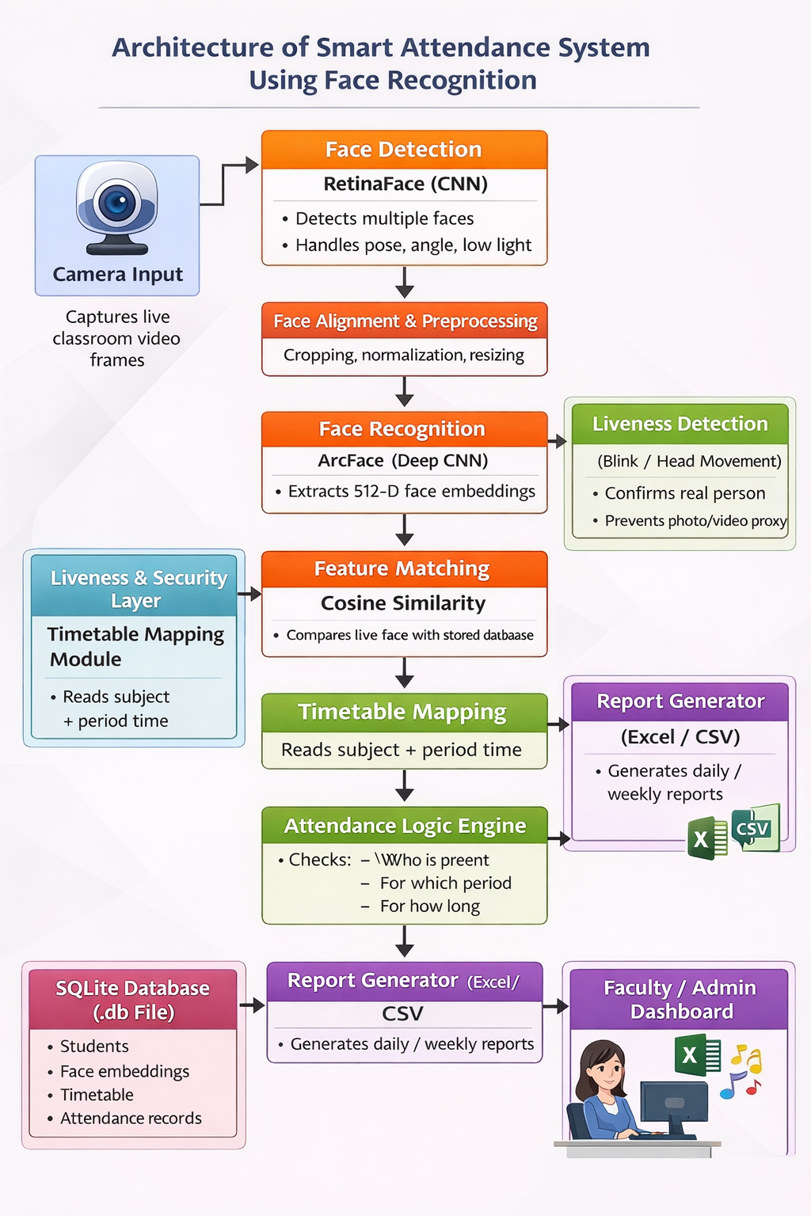
ARCHITECTURE

Slide 8
ALGORITHMS
• Retina Face (Face Detection):
Detects and localizes faces accurately in classroom video frames.
• Arc Face (Face Recognition):
Extracts highly discriminative face embeddings to identify students.
• Cosine Similarity (Matching):
Compares face embeddings to determine identity similarity.
• Blink / Head-Movement Detection (Liveness):
Ensures the detected face is a real person, not a photo or video.
• Rule-Based Attendance Logic:
Maps recognized faces to timetable periods and marks attendance.

Slide 9
Existing System
Technology Used: Face recognition using YOLO, ResNet-34, ArcFace, OpenCV (LBPH), and CNN is widely used for attendance as it is contactless and prevents proxy, unlike fingerprint or GPS methods.
Advanced Features: Systems include attention tracking, cloud analytics, Excel reports, real-time alerts, and dashboards for monitoring attendance and student engagement.
Common Limitations: These systems require good lighting, proper distance (2–3m), limited angles, may slow with large data, and raise privacy concerns.
Performance Results: They reduce attendance time by up to 95%, achieve high accuracy (90–95%), prevent proxy, and support large classes efficiently.

Slide 10
Proposed Work
Develop a Face Recognition Based Attendance System
Secure Admin Face Authentication
Real-Time Multi-Face Detection & Recognition
Automated Attendance Management with Reporting
Liveness Detection & Auto-Absent Mechanism

Slide 11
REQUIREMENTS
Functional Requirements
Capture live video
Detect and recognize faces
Enroll new students
Monitor presence continuously
Generate attendance report

Slide 12
Non‑Functional Requirements
Fast response time
Easy to use
Secure student data
Reliable in classroom conditions
Hardware Requirements
Laptop (HP, 64‑bit)
Webcam
Minimum 8 GB RAM
Intel i5 or above recommended

Slide 13
Software Requirements
Windows 10/11
Python 3.9+
OpenCV
CRUD Operations(Timetable)
Insight Face (Arc Face)
SQLite / CSV

Slide 14
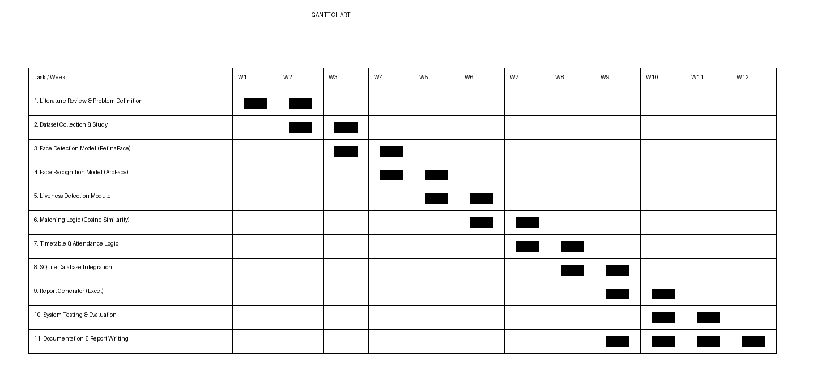
GANTT CHART

Slide 15
CONCLUSION
This project presents an AI‑based smart attendance system using facial recognition with continuous presence monitoring.The system effectively eliminates proxy attendance, reduces manual effort, and ensures genuine student participation. By using deep learning techniques like Arc Face, the system achieves high accuracy and is suitable for real classroom environments.

Slide 16
REFERENCES
Parhi, M., Roul, A., Ghosh, B. and Pati, A., 2022. Ioats: an intelligent online attendance tracking system based on facial recognition and edge computing. International Journal of Intelligent Systems and Applications in Engineering, 10(2), pp.252-259.
Satpute, N., Bharti, N., Uikey, A., Wati, R. and Chakole, V.V., Online Classroom Attendance Marking System Using Face Recognition, Python, Computer Vision, and Digital Image Processing. Int. J. Res. Appl. Sci. Eng. Technol, 10(2), pp.768-773.
Samal, P.A.IyenGar. “Automatic Recognition and Analysis of Human Faces and Facial Expressions: A Survey, Pattern Recognition”, 25(1), pp65-77, 1992
Wei Lu, “Research and Implementation of Face Detection and Recognition based on Android Platform” [D], Southwest Jiaotong University, 2014.
Ramesh, Nvk & Sumer, Md & Poojita, M & Akhil, T & Deevena, B. (2020). An Efficient Way to Monitoring Attendance using Face Recognition Technology. 83. 6235

Slide 17
REFERENCES
Kumar, Ashu & Kaur, Amandeep & Kumar, Munish. (2019). Face Detection Techniques: A Review. Artificial Intelligence Review. 52. 10.1007/s10462-018-9650-2.
Vaz, F. Antony Jeffrey, et al. "Smart Attendance System using RFID and Raspberry Pi." 2023 Second International Conference on Electronics and Renewable Systems (ICEARS). IEEE, 2023.
Goud, Suraj, et al. "Smart Attendance Monitoring System for Online Classes Using Facial Recognition." International Conference on Innovative Computing and Communications: Proceedings of ICICC 2022, Volume 2. Singapore: Springer Nature Singapore, 2022.
Shailendra, M. Singh, M. A. Khan, V. Singh, A. Patil and S. Wadar, "Attendance management system," 2015 2nd International Conference on Electronics and Communication Systems (ICECS), 2015, pp. 418-422, doi: 10.1109/ECS.2015.7124938.
G. Sittampalam and N. Ratnarajah, "SAMS: An IoT Solution for Attendance Manageme nt in Universities," TENCON 2019 - 2019 IEEE Region 10 Conference (TENCON), 2019, pp. 10.1109/TENCON.2019.8929616.

